Slide 1
THE KC HOUSE PROJECT

Slide 2
The Goal
To build understand the factors that can predict the impact of home renovations on the estimated value of houses.
To help the real estate agency provide homeowners with actionable recommendations on which renovations are most likely to yield a higher return on investment

Slide 3
Factors that affect the buying of a house
Location i.e lat, long
Price of the house
Number of bedrooms
Number of bathrooms
Square footage of the living space
Square footage of the lot
Total floors in the house
Whether the house is on a waterfront
Grading level around the house
Square footage of the house apart from the basement
Square footage of the basement area
Year when the house was built
Year when the house was renovated
Zip code of the house
Special view
Conditional of the house

Slide 4
DATA HANDLING METHODS USED :
Data cleaning
Handling outliers
Handling duplicated
Explanatory analysis
Data analyis
Data modelling /predictive analysis
Data visualization

Slide 5
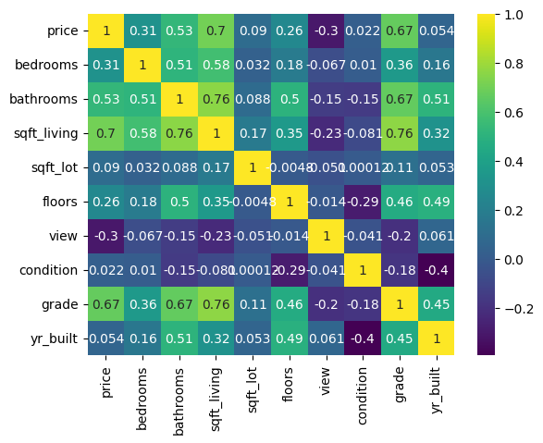
To check the correlation between the variables

Slide 6
There is a close relationship between the price of a house and the grade where the fact on whether a house is a graded as a mansion,luxury,excellent, better it will affect the price of the house.

Slide 7
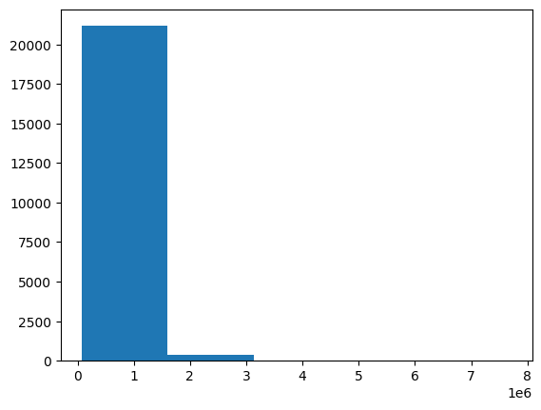

Slide 8
Linear Regression - Price vs. Grade
We analyzed the relationship between the price of a house and its grade.
A scatter plot revealed a positive correlation between the two variables. We built a linear regression model to predict the impact of grade on price. The model's coefficients, intercept, and performance metrics (RMSE, R2 score) were presented.
To use this analysis to understand the influence of grade on the estimated value of their properties.

Slide 9
Linear Regression - Price vs. Sqft_living
We examined the relationship between the price of a house and its square footage of living space. A scatter plot demonstrated a positive correlation. We constructed a linear regression model to predict the price based on the square footage. The model's coefficients, intercept, and performance metrics (RMSE, R2 score) were shared.
to leverage this analysis to gauge the effect of square footage on their property's estimated value.

Slide 10
Multiple Linear Regression Model
To predict the price, we employed a multiple linear regression model considering various variables, including bathrooms, bedrooms, sqft_lot, sqft_living, floors, and more. The coefficients and performance metrics (MSE, R-squared) for both training and testing sets were presented
Homeowners can benefit from this analysis by understanding how these variables collectively influence the estimated value of their properties.

Slide 11
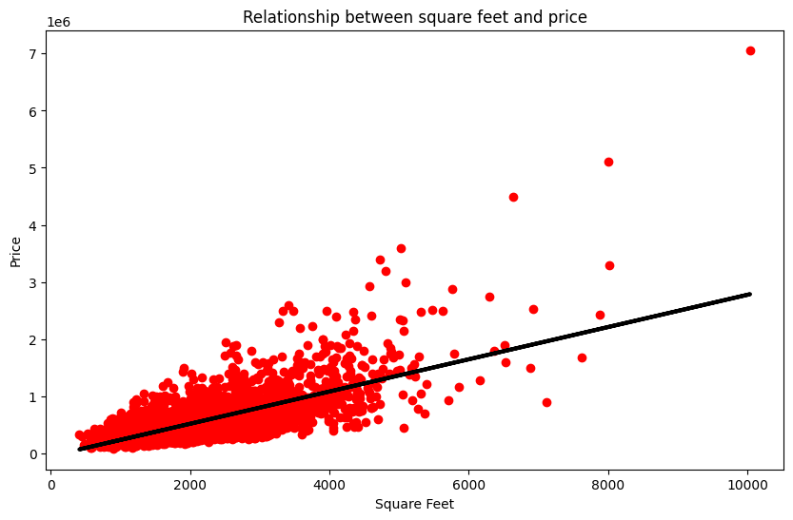

Slide 12
Polynomial Regression
We applied polynomial regression to predict price based on variables like bathrooms, bedrooms, sqft_lot, sqft_living, floors, and more. Polynomial features were used to capture non-linear relationships. Performance metrics (MSE, R-squared) for both training and testing sets were shared.
To gain insights into the non-linear impact of these variables on property value.

Slide 13
Recommendations Based on our analysis,
Focus on improving the grade of your property as it has a significant positive impact on the estimated value.
Consider expanding the square footage of the living space to potentially increase the property's price.
Take into account the number of bathrooms, bedrooms, and other features that contribute to the property's value.
Prioritize renovations that align with the preferences and demands of potential buyers in the market.

